Slide 1

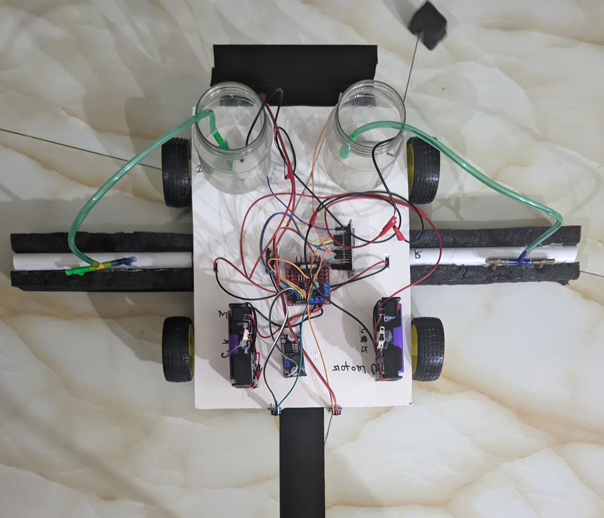
Team AL-FATAH
Line Follower Solar Panel Cleaner

Slide 2
Instructor
AbHn Md. Abid Hossain
United International University
Team Members
011221073
011221117
011221601
011221126
011221136
Md Shazzad Hossain Jiku
Ananna Saha
Md. Ammar Hossain
Shraboni Akter Mim
Mohammad Sameer Ahmed

Slide 3
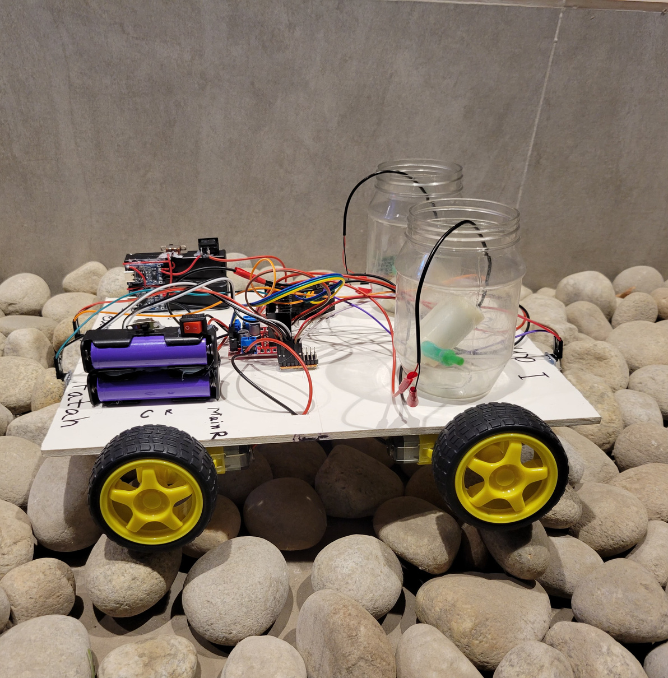
Introduction to
SPC
The global shift towards renewable energy makes solar panels crucial. However, they accumulate dust and debris, reducing their efficiency.
The Line Follower Solar Panel Cleaner Robot autonomously follows a path on solar panels, cleaning them efficiently and reducing the need for labor-intensive manual cleaning.

Slide 4
Motivation
The motivation behind this project is to reduce human intervention in solar panel maintenance.
Manual cleaning can be expensive and inefficient, especially in large solar farms or areas with extreme weather.
This autonomous solution ensures regular cleaning, increasing energy output while minimizing costs.

Slide 5
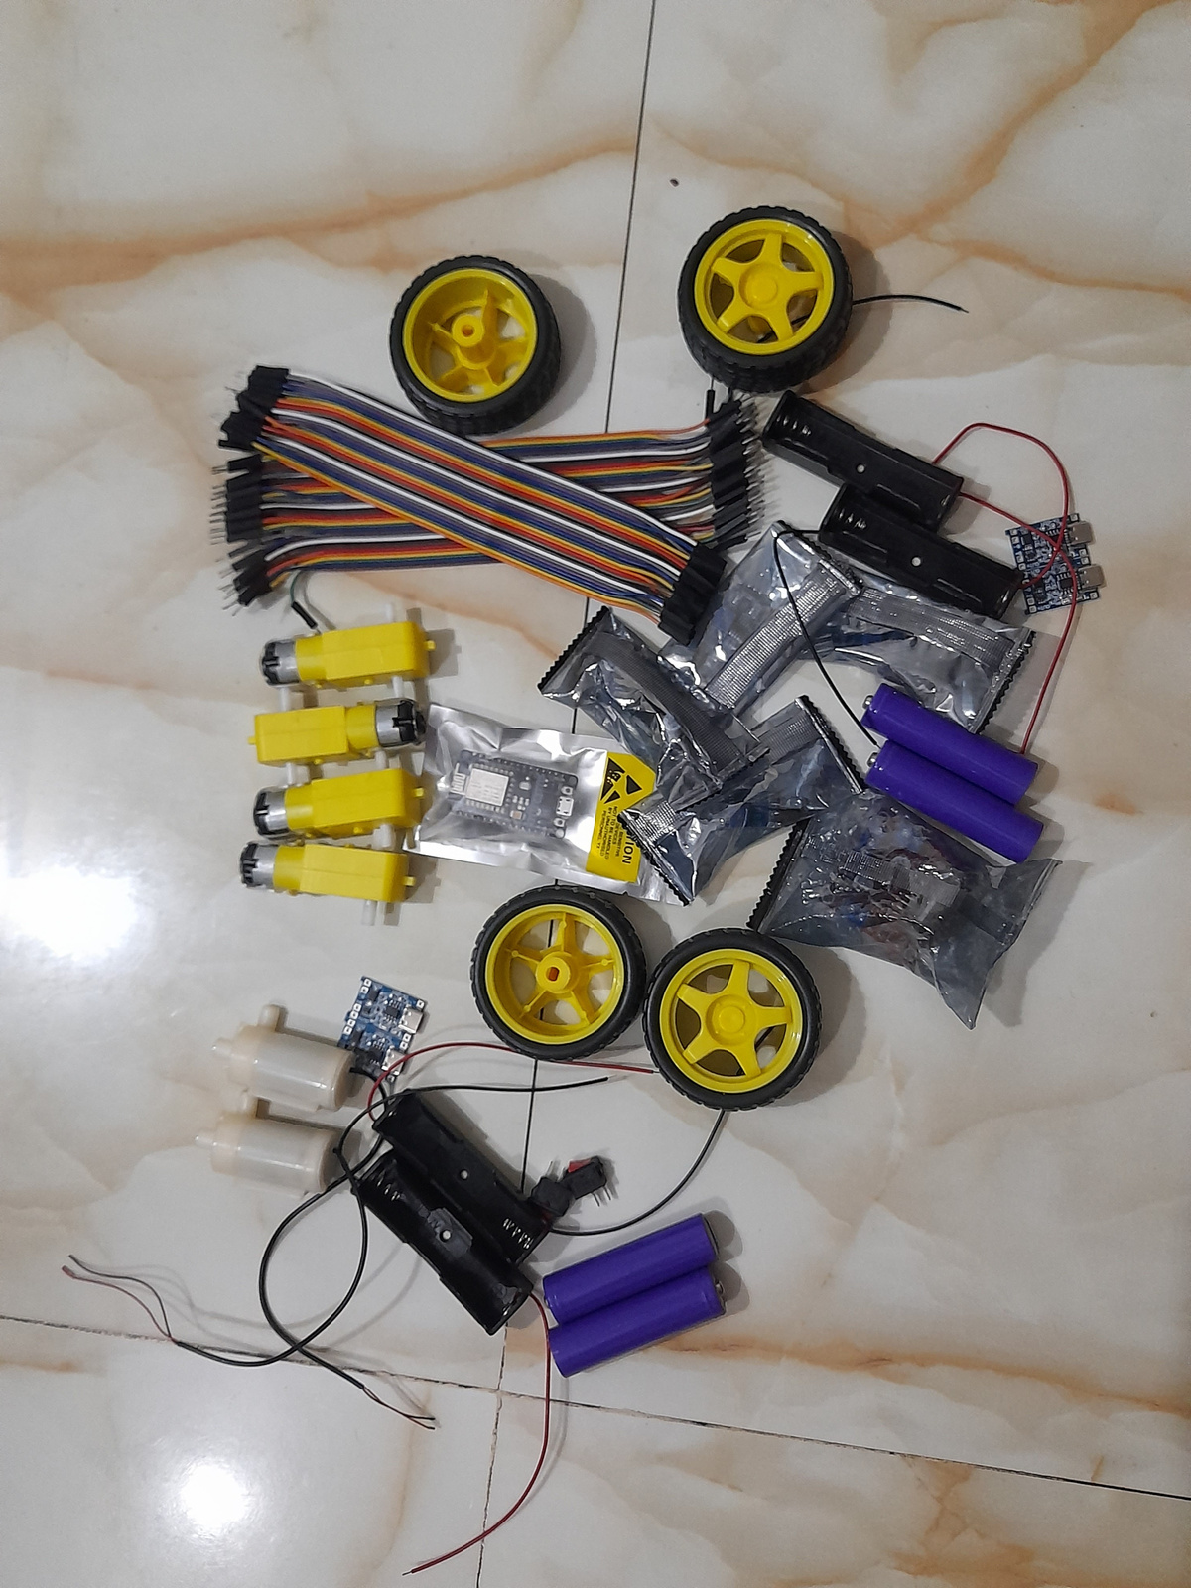
ESP 32- microcontroller to control the robot🤖
IR Sensors - for navigation 💡
Components
Motor Driver ( L298N )- control motors
DC Motors- provide movement to motors
Chassis - body for the robot
Wheels - for mobility🛞
Battery ( LiPo )- power supply🔋
Jumper wires - Connects the components
Switch - Power on/off control 🖲️
Converter - Bug module
Solar panel - Surface 🔲
Water pump and cleaning mechanism - spray water, Foam, connector etc.

Slide 6
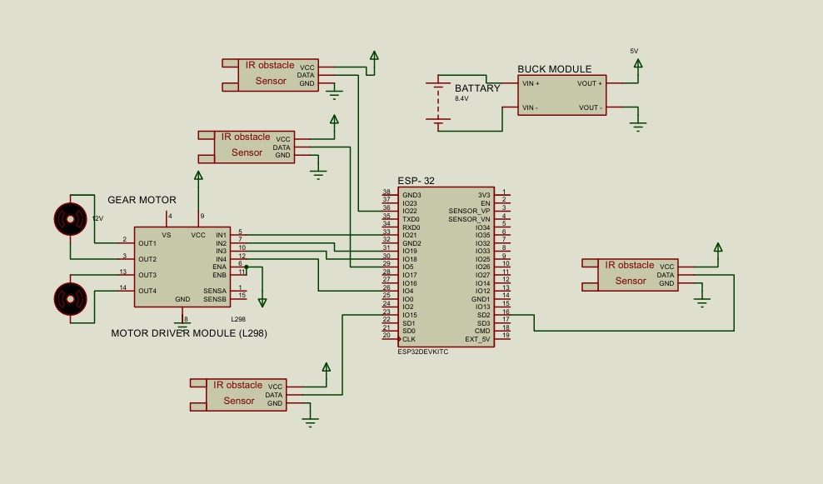
System Architecture
The proposed system consists of several components working together to ensure the robot autonomously follows a path and cleans the solar panels.

Slide 7
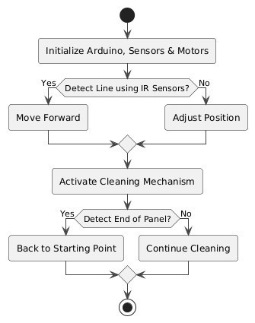
System Flowchart

Slide 8
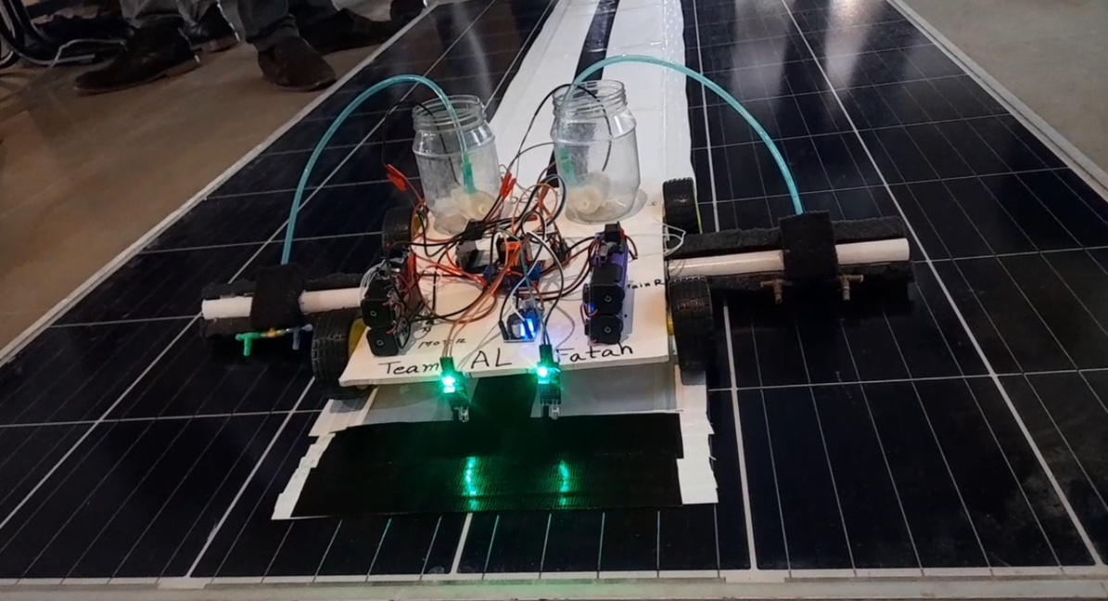
Features of SPC
1. Automated Cleaning Mechanism
2. Line-Following Technology
3. Waterless Cleaning Solution
4. Efficient Power Management

Slide 9
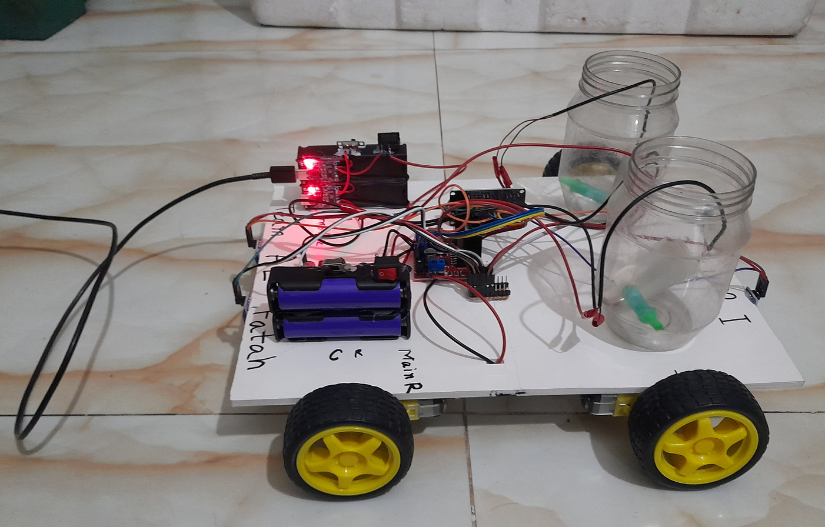
Features of SPC
5. User-Friendly Interface
6. Customizable Design
7. Charging System
8. Cost-Effective Solution

Slide 10
Week | Task | Duration (Days) & work (%)
Week 1 | System Design & Component Selection: Arduino, sensors, motors, cleaning mechanism, etc. 2. Purchase Components & Basic Circuit Assembly 3. Mechanical Assembly: Attach Motors, Wheels, Sensor | => 7 Days => 25% completed
Week 2 | Integrate Line-Following Sensors with Motor Control 2. Program Line Following Logic & Test Sensors 3. System testing and debugging | 7 Days => 60% completed
Week 3 | 1. Implement Cleaning Mechanism 2. System Integration: Combine Line Following & Cleaning Mechanism 3. Full System Testing & Debugging 4. Final Adjustments & Documentation | =>7 Days => 100% completed
Gantt Chart

Slide 11
Component | Quantity | Cost
1. Arduino Uno | 1 | 530
2. Line Follower | 1 | 100
3. IR Sensors (Line Following) | 2 | 200
4. DC Motors | 2 | 275+275
5. Motor Driver (L298N) | 1 | 210
6. Cleaning pipe & Foam | 1 | 150
7. Wheels/Chassis | 1 set | 300
8. Battery | 4 | 250+250+150+150
9. Battery Holder | 3 | 80+30+30
10. Water Pump | 1 | 50
11. DC Switch | 3 | 20+10+10
12. USB Cable | 1 | 135
13. Cleaning Spray | 1 | 120
14. Saline Pipe & T-Spliter |  | 200
15. Miscellaneous (wires, connectors, etc.) |  | 250
16. Other Cost |  | 500
Total Cost |  | 4275
Budget Estimation

Slide 12
Conclusion
In this project, we successfully developed a Line Follower Robot for Automated Solar Panel Cleaning. The robot utilizes an Arduino-based control system, IR sensors, and a cleaning mechanism to autonomously navigate solar panels, ensuring efficient dust and debris removal. The implementation of the cleaning system achieved an efficiency of 90% to 97%, making it a viable solution for maintaining solar panel performance.
This project not only addresses the operational challenges of solar panel maintenance but also opens doors for further innovation and improvements in industrial automation.

Slide 13
Thank You
Team AL-Fatah

